Slide 1


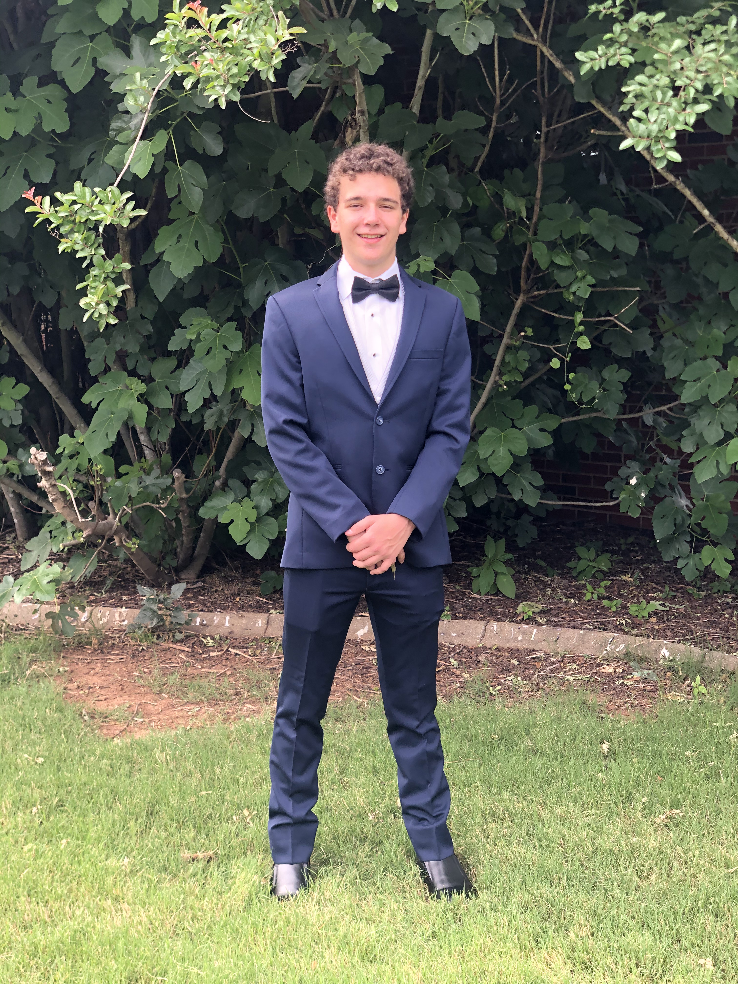
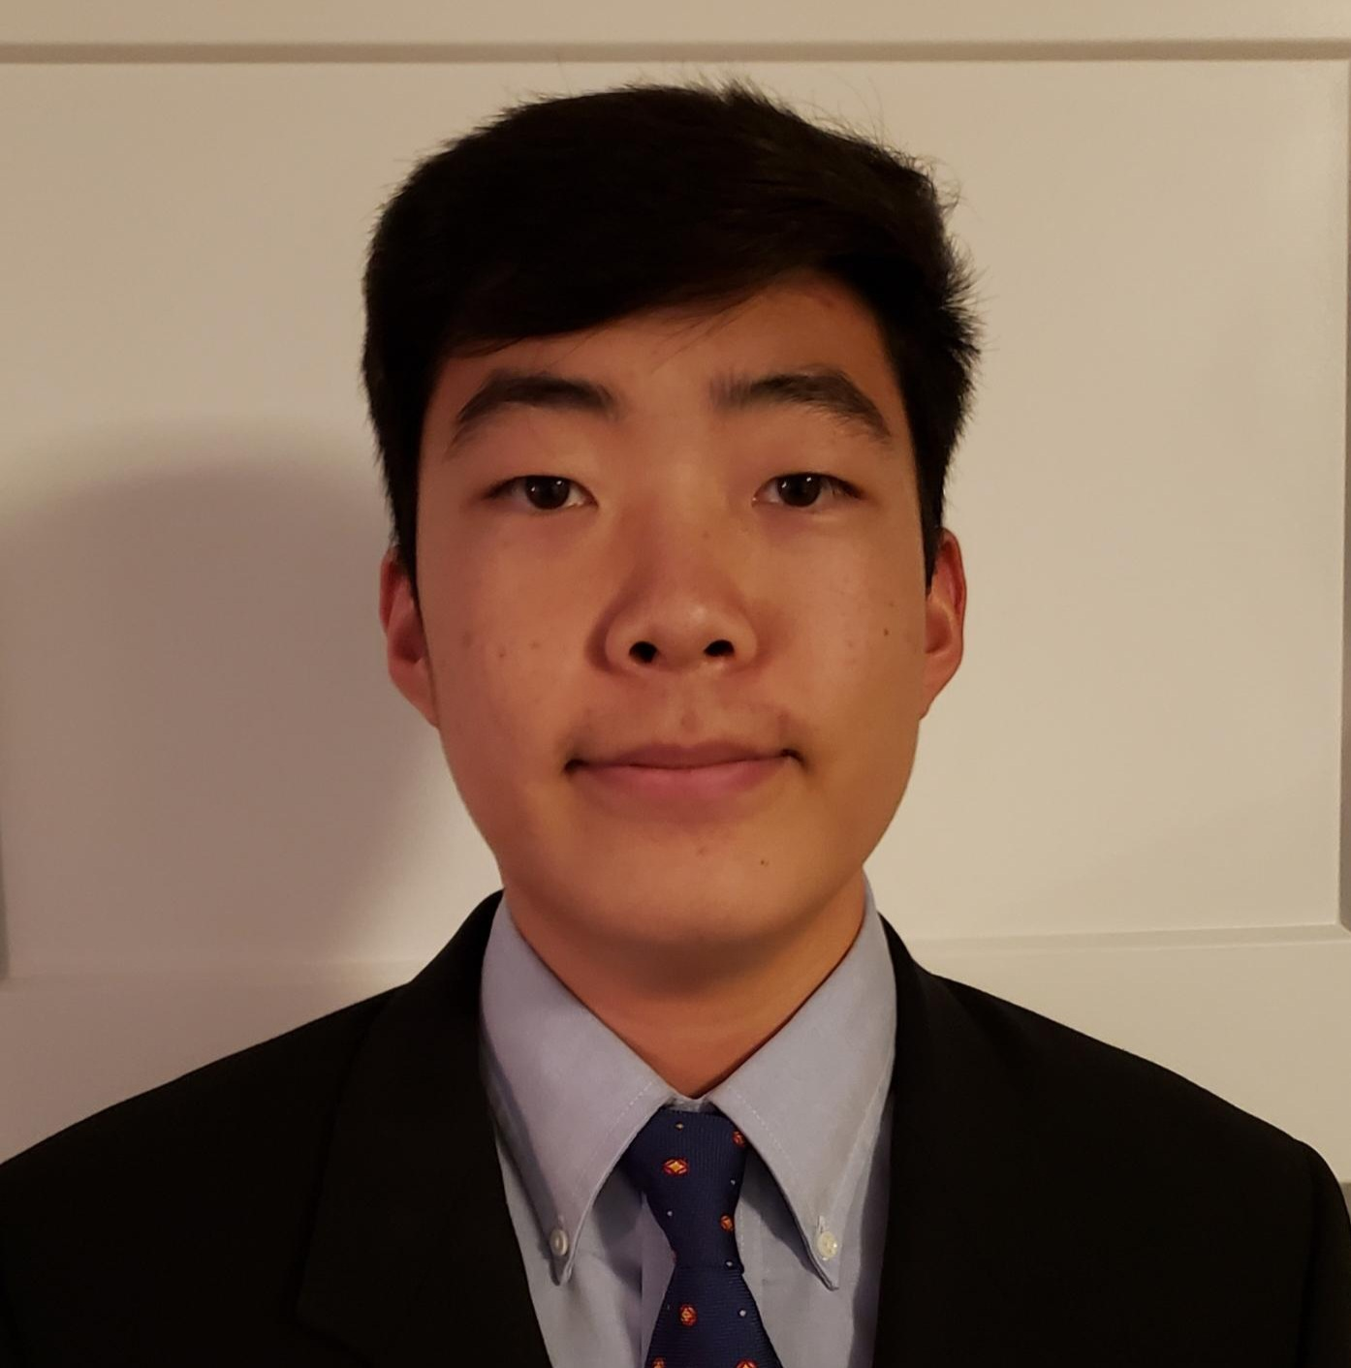

Apple Vision Pro Sprint 3
GitHub Source Code: https://github.com/Apple-Vision-Pro-UA-CS495
Project Website: https://apple-vision-pro-ua-cs495.github.io/project-website/
Documentation Website: https://apple-vision-pro-tutorial.readthedocs.io/en/latest/
Donovan Kohler Trang Do Anthony Rutherford Sam Kwon Raudel Armenta

Slide 2
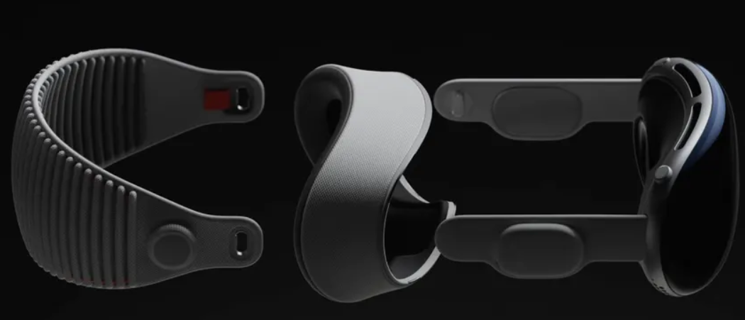
Project Overview
Set up initial infrastructure for future development with the Vision Pro and cloud computing
Build a visionOS app that uses data from Apple Vision Pro to provide distributed intelligence
Leverage Hugging Face models for machine learning capabilities
Notes:
Send information between Apple Vision Pro and server for information processing or use of AI models
Distributed intelligence
Client-server architecture

Slide 3
High-Level Implemented Functionality
App-Side:
Connects to WebSockets
Display classification results by having the app parse the JSON response from server
Connect to OpenAI's chat completion API
Assistants reply (or error) is passed to the completion handler

Slide 4
High-Level Implemented Functionality
Server-Side:
Receive image as base64 and convert to Image type using WebSockets
Send image through model hosted on cloud server
Send results back to visionOS application
Long wait times avoided by using server that does not require a cold start

Slide 5
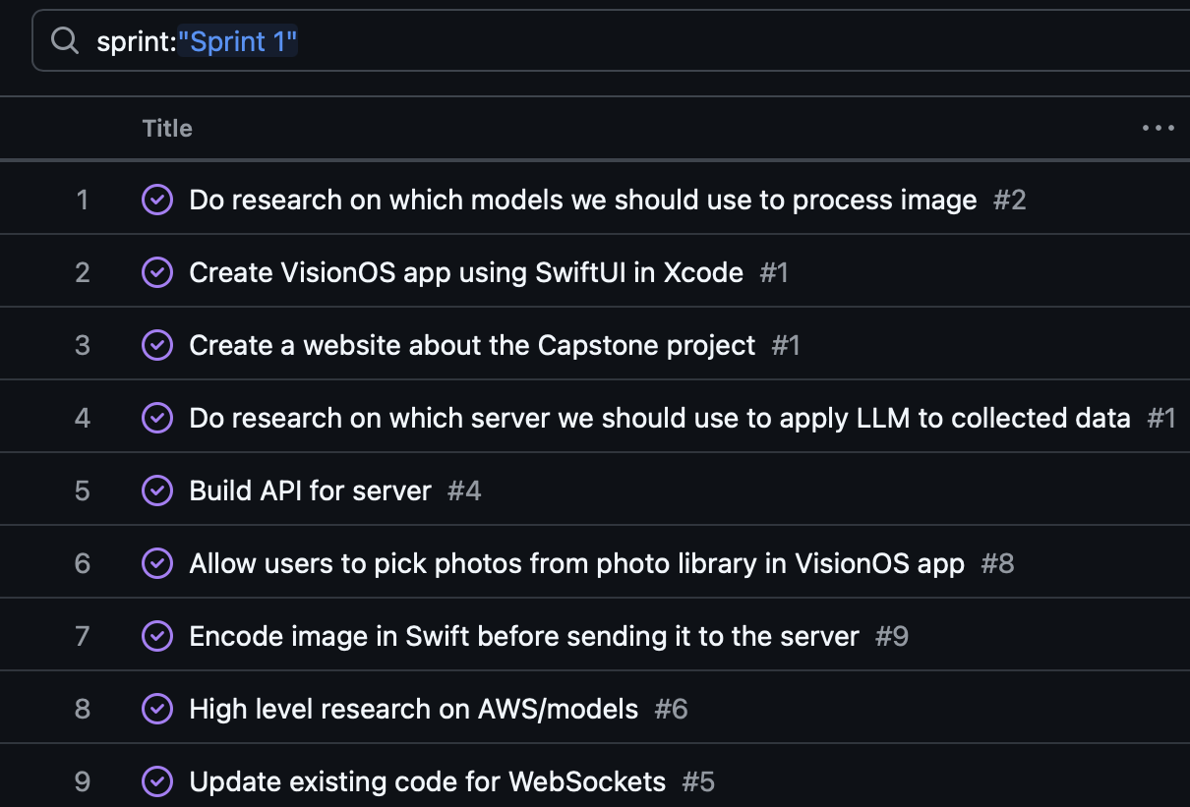
Sprint 1 Backlog Highlight https://github.com/orgs/Apple-Vision-Pro-UA-CS495/projects/1/views/1
Primary Focus:
VisionOS app (send image feature)
Hugging Face models
Backend data processing code
Lower Priority:
Project website
Notes:
Developing the visionOS app that allows users to pick an image from the Photo app and send it to the backend via WebSocket
Researching the LLM models from Hugging Face to process data, setting up AWS, and writing code for the backend
Creating a basic project website

Slide 6
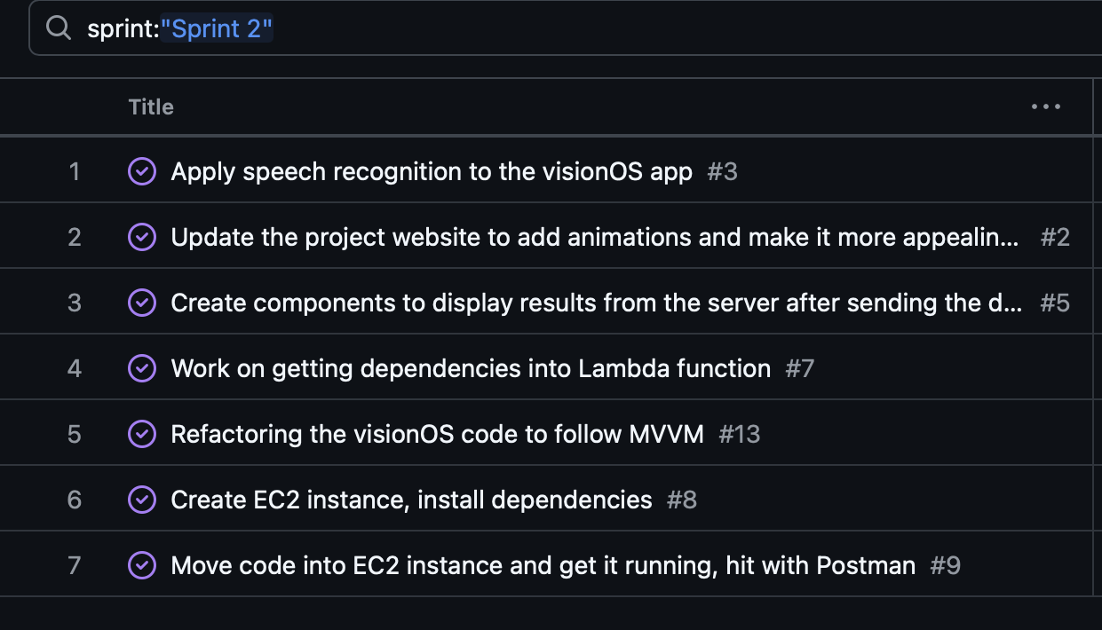
Sprint 2 Backlog Highlight https://github.com/orgs/Apple-Vision-Pro-UA-CS495/projects/1/views/1
Primary Focus:
VisionOS app (speech recognition, display result)
Install dependencies on AWS
Project website
Notes:
Applying speech recognition and displaying the result from the data processing in AWS on the visionOS app
Installing dependencies within AWS (from Lambda to EC2)
Make the project website more appealing and user-friendly

Slide 7
Sprint 3 Backlog Highlight https://github.com/orgs/Apple-Vision-Pro-UA-CS495/projects/1/views/1
Allow users to use voice recognition and send a request to OpenAI
Work on the documentation website
Do research on unit testing in Xcode and write unit tests for the visionOS app
Write unit tests for the backend
Make security updates based on recommendations from the cybersecurity team
Add screen recording for software installation and features to documentation website
Primary Focus:
VisionOS app (OpenAI Integration)
Documentation website
Ensure Security
Unit Testing
Notes:
Applying speech recognition and displaying the result from the data processing in AWS on the visionOS app
Installing dependencies within AWS (from Lambda to EC2)
Make the project website more appealing and user-friendly

Slide 8

Demo
Notes:
https://www.youtube.com/watch?v=ihywh1OfG-Y

Slide 9
Thank you!

